Slide 1
Embedded Operating Systems
6.2 Linux Kernel Module Programming
Shripad V Deshpande

Slide 2
Kernel Modules
• Kernel modules are piece of code, that can be loaded and
unloaded from kernel on demand.
• Kernel modules oﬀers an easy way to extend the
functionality of the base kernel without having to rebuild
or recompile the kernel again. Most of the drivers are
implemented as a Linux kernel modules. When those
drivers are not needed, we can unload only that speciﬁc
driver, which will reduce the kernel image size.
• The kernel modules will have a .ko extension. On a
normal linux system, the kernel modules will reside inside
/lib/modules/<kernel_version>/kernel/ directory.

Slide 3
Examples:
• Typical modules:
– Device drivers
– File system drivers
– System calls

Slide 4
Advantages
• There is no necessity to rebuild the kernel,
when a new kernel option is added.
• Modules help ﬁnd system problems (if
system problem caused a module just don't
load it).
• Modules are much faster to maintain and
debug.
• Modules once loaded are in as much fast as
kernel.

Slide 5
Utilities to manipulate kernel modules
•
•
•
•
•
lsmod
insmod
modinfo
rmmod
modprobe

Slide 6
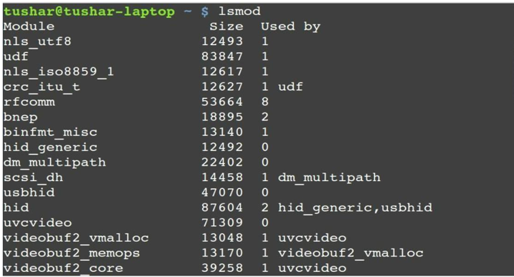
lsmod
• Lists modules that are loaded already.
• Check the command:
cat /proc/modules

Slide 7
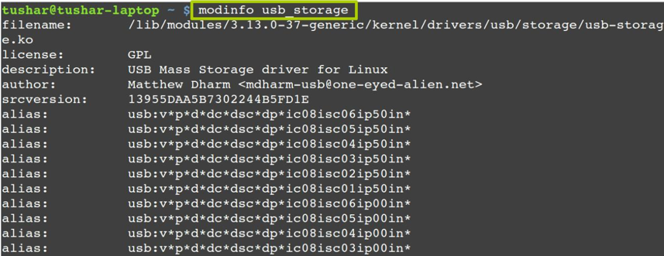
modinfo
• Display module information.

Slide 8
insmod
• Insert module into kernel.
• Syntax:
– insmod <module_name>.ko

Slide 9
rmmod
• Removes module from kernel. You cannot
remove a module which is already used by
any program.
• Syntax:
–rmmod <module_name>.ko

Slide 10
Kernel Module Implementation
• The kernel considers only modules that have been
loaded into RAM by the insmod program and for
each of them allocates memory area containing:
– A module object.
– Null terminated string that represents module's
name.
– The code that implements the functions of the
module.

Slide 11
Linux Kernel Module Programming
• Write a hello_proc.c program
• Create a Makeﬁle
• The program and Makeﬁle should be kept in a single
folder.
• Change directory to this folder and execute following:
– make
– insmod hello_proc.ko
– dmesg
log ﬁle /var/log/syslog)
(see the kernel buﬀer contents, reads the kernel
– lsmod
– cat /proc/hello_proc

Slide 12
Files created after building the module
• hello.o
– Module object ﬁle before linking.
• hello.mod.c
– Contains module’s information.
• hello.mod.o
– After compilation and linking of hello.mod.c.
• modules.order
– The order in which two or three modules get linked.
• Modules.symvers
– Symbol versions if any.
• hello.ko
– A module kernel object ﬁle after linking hello.o and hello.mod.o

Slide 13
Example: hello.c
#include <linux/module.h>
#include <linux/kernel.h>
#include <linux/init.h>
MODULE_LICENSE("GPL");
// included for all kernel modules
// included for KERN_INFO
// included for __init and __exit macros
MODULE_AUTHOR("My Name");
MODULE_DESCRIPTION("A Simple Hello World module");
static int __init hello_init(void)
{
printk(KERN_INFO "Hello world!\n");
return 0; // Non­zero return means that the module couldn't be
loaded.
}
static void __exit hello_cleanup(void)
{
printk(KERN_INFO "Good Bye.\n");
}
module_init(hello_init);
module_exit(hello_cleanup);

Slide 14
Makeﬁle
obj­m += hello.o
all:
make ­C /lib/modules/$(shell uname ­r)/build M=$(PWD)
modules
clean:
make ­C /lib/modules/$(shell uname ­r)/build M=$(PWD)
clean

Slide 15
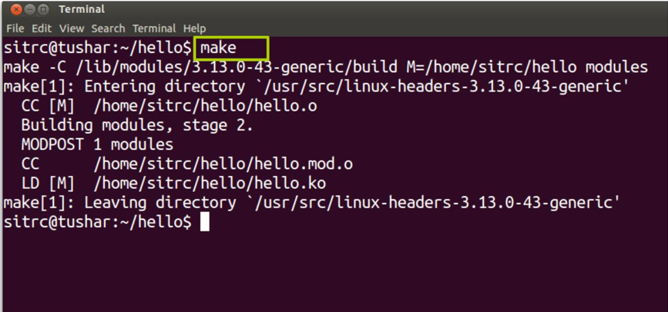
Compile the program
•
make

Slide 16
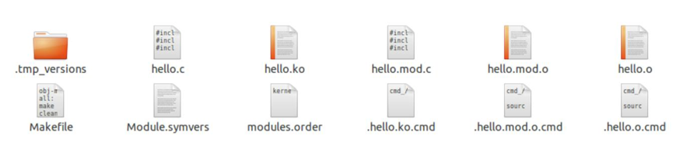
File generated

Slide 17
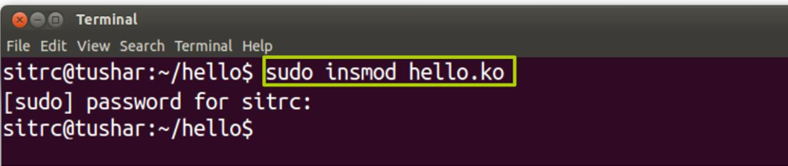
•
insmod hello.ko

Slide 18
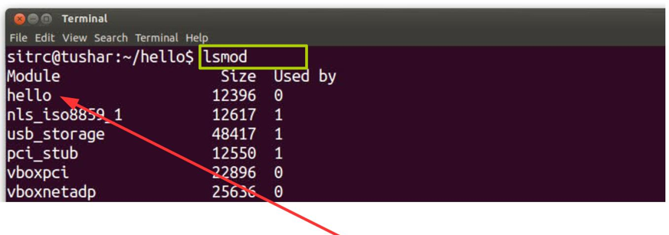
Check the module in the list
•
lsmod
hello module

Slide 19
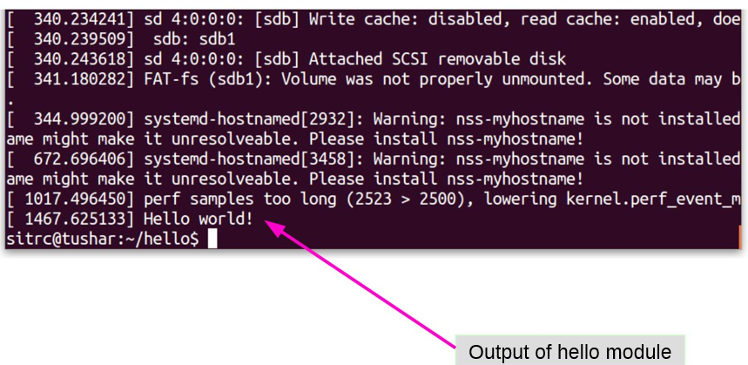
Check kernel ring buﬀer
•
dmesg

Slide 20
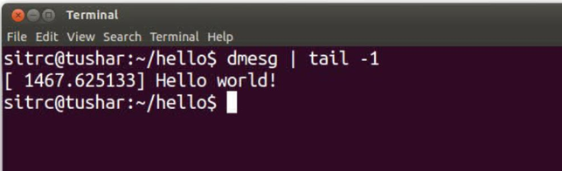
Check kernel ring buﬀer
•
dmesg | tail ­1

Slide 21
Removing the module
•
•
•
rmmod hello.ko
dmesg
or
dmesg | tail ­1

Slide 22
What is dmesg?
• The dmesg command is used to write the kernel
messages in Linux and other Unix-like operating
systems to standard output (which by default is the
display screen).
• dmesg obtains its data by reading the kernel ring buﬀer.
A buﬀer is a portion of a computer's memory that is set
aside as a temporary holding place for data that is being
sent to or received from an external device, such as a
hard disk drive (HDD), printer or keyboard.
• A ring buﬀer is a buﬀer of ﬁxed size for which any new
data added to it overwrites the oldest data in it.

Slide 23
What is printk?
• The kernel print function, printk( ), behaves almost
identically to the C library printf( ) function.
• printk( ) is simply the name of the kernel's formatted
print function. It is callable from just about anywhere in
the kernel at any time.
• The major diﬀerence between printk( ) and printf( ) is
the capability of the former to specify a loglevel.
• The kernel uses the loglevel to decide whether to print
the message to the console. The kernel displays all
messages with a loglevel below a speciﬁed value on the
console.

Slide 24
printk : example
printk(KERN_WARNING "This is a warning!\n");
printk(KERN_DEBUG "This is a debug notice!\n");
printk("I did not specify a loglevel!\n");

